Slide 1






CSP4141 ~ Occupancy Modeling
Review of Statistical Concepts and Modeling

Slide 2
Models: Fisheries & Wildlife Management
There is no “true” model that generates biological data.
Truth in biological sciences has essentially infinite dimensions; hence, full reality cannot be revealed with finite samples.
Biological systems are complex with many small effects, interactions, individual heterogeneity, and environmental covariates.
All models are approximations of reality.
True: everyone is a ‘modeler’

Slide 3

Models as Hypotheses
Models $≠$ Hypotheses
Hypotheses are unproven theories or suppositions that are tentatively accepted to explain facts or serve as the basis for further investigation
Models are explicit representations of hypotheses
Several models can represent a single hypotheses
Models are tools for evaluating hypotheses

Slide 4
Model Selection
Goals of model-fitting
Determine the best explanation given the data
Determine the best model for predicting the response
Two general approaches are widely used in fisheries and wildlife ecology:
Likelihood Ratio Tests (LRT)
Information Theoretic Approaches (IT)

Slide 5
Model Selection
Likelihood Ratio Tests
Formal test used to compare nested models.
Tests results depend on pre-defined threshold, e.g,. α = 0.05.
Comparing multiple models requires a (sometimes) confusing list of pair-wise comparisons.
Useful when direct comparisons between two models are being conducted.

Slide 6
Model Selection
Information Theoretic Approaches
Useful for comparing nested and non-nested models.
Balance explanatory power and model complexity via penalty for adding parameters.
Useful when assessing relative support for >2 models.
Also relies on pre-defined thresholds for comparison.

Slide 7
Information Theoretic Approaches
If full reality cannot be included in a model, how do we tell how close we are to truth?
Truth
Model2
Model1
Kullback-Leibler (K-L) distance is based on IT
Measures information accounted for in a model

Slide 8
Information Theory
Akaike’s Information Criterion (AIC)
K-L distance represents information lost when a candidate model is used to approximate truth.
Small values = better fit
Akaike showed that the maximum log-likelihood was related to K-L distance.
Akaike’s Information Criterion (AIC) is based on the concept of minimizing K-L distance.

Slide 9
What is a Likelihood?
Defined as the likelihood of the observed data given the model (parameters).
Likelihood function varies with the type of statistical model being used, e.g., binomial, normal, Poisson, etc.
Usually more convenient to work with the log likelihood.
MLEs = value(s) of model parameter(s) that maximize the log likelihood (or minimize the negative log likelihood).

Slide 10
AIC: Akaike’s Information Criterion
Maximum log likelihood is a biased estimate of K-L distance
Akaike showed that:
AIC = -2ln(likelihood|data)) + 2K
AIC is based on the principle of parsimony
AIC = -2ln(likelihood|data) + 2*K
Measures model lack of fit
Penalty for increasing model size
(enforces parsimony)

Slide 11
AIC: Akaike’s Information Criterion
Maximum log likelihood is a biased estimate of K-L distance
Akaike showed that:
AIC = -2ln(likelihood|data)) + 2K
AIC is based on the principle of parsimony
AIC = -2ln(likelihood|data) + 2*K
Measures model lack of fit
Penalty for increasing model size
(enforces parsimony)

Slide 12
AICc: Small Sample Bias Adjustment
If ratio of n/K is < 40 then use AIC_{c}
AICc = -2*ln(likelihood|data) + 2*K + (2*K*(K+1))/(n-K-1)
You may also see AICc calculated this way, which is equivalent:
AICc = -2*ln(likelihood|data) + 2*K*(n/(n-K-1))
As n gets big:
(2*K*(K+1))/(n-K-1) = 1/very large number
(2*K*(K+1))/(n-K-1) = 0
AIC = AICc for large datasets; usually best to use AICc

Slide 13
Model Selection with AIC
How is AIC used?
AIC by itself is relatively meaningless.
We find the best model by comparing various models and examining their relative distance to the “truth”
We do this by calculating the difference between the best fitting model (lowest AIC) and the other models.

Slide 14
Model Selection with AIC
Model selection uncertainty
Model rankings would likely change if study were conducted again.
AIC weights express relative support for a set of models, given the data
Often useful to develop a “confidence set” of models based on some criterion (e.g., based on AIC weights or differences in AIC)

Slide 15
Goodness of Fit
Does a low AIC mean I have a good model?
No, given a candidate set of models, one of them will always have the lowest AIC, and they may all be poor models.
AIC says nothing about how well a model fits the data or if model assumptions were met.

Slide 16
Assessing Goodness of Fit
Measures of goodness of fit typically summarize discrepancy between observed values and expected values under the model in question.
Various procedures can be used to assess fit of linear models.
e.g,. Fit of occupancy models can be assessed by comparing observed vs expected frequencies of encounter histories (MacKenzie and Bailey 2004).

Slide 17
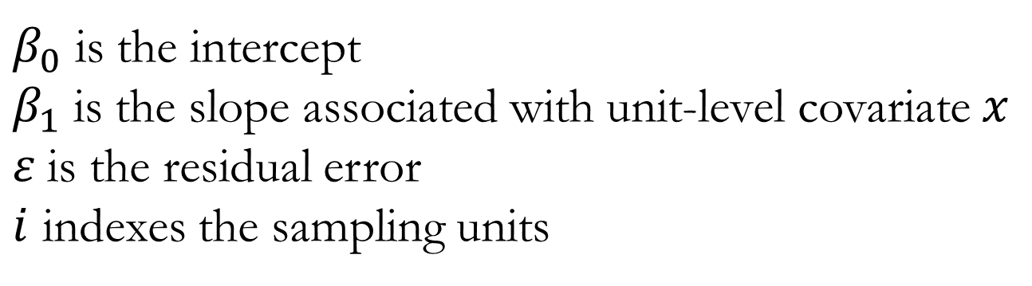
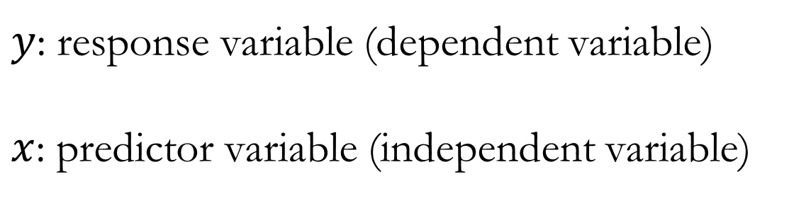
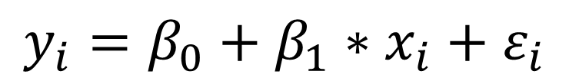
Linear Modeling Review
Recall the general linear regression:
$y$: response variable (dependent variable)
$x$: predictor variable (independent variable)
$$y_{i}=β_{0}+β_{1}∗x_{i}+ε_{i}$$
$β_{0}$ is the intercept
$β_{1}$ is the slope associated with unit-level covariate $x$
$ε$is the residual error
$i$ indexes the sampling units

Slide 18
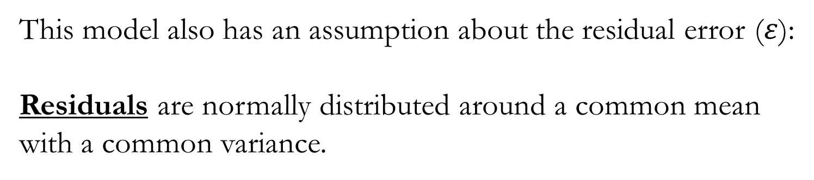
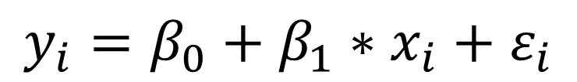
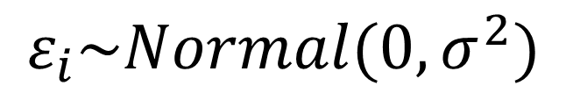
Linear Modeling Review
$$y_{i}=β_{0}+β_{1}∗x_{i}+ε_{i}$$
This model also has an assumption about the residual error ($ε$):
Residuals are normally distributed around a common mean with a common variance.
$$ε_{i}\sim Normal(0,σ^{2})$$

Slide 19
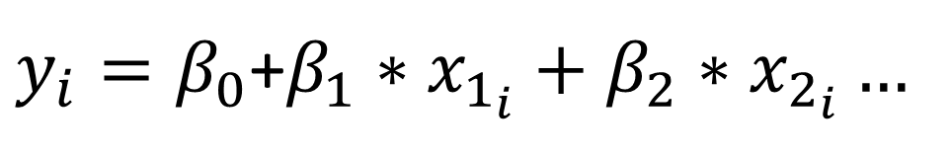
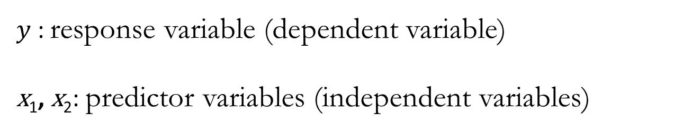
Generalized Linear Models
The general linear regression is actually a special case of a larger set of models called generalized linear models (GLMs) that all take the same basic form….
$y_{i}=β_{0}$+$β_{1}∗x_{1_{i}}+β_{2}∗x_{2_{i}}…$
$y$: response variable (dependent variable)
x₁, x₂: predictor variables (independent variables)
GLMs allow for response variables that have error distribution models other than a normal distribution.

Slide 20
Generalized Linear Models
A GLM consists of three components:
A statistical distribution that describes random variation in the response.
A linear combination of covariate effects (linear predictor)
A link function that specifies how the expected value of the response relates to the linear predictor.

Slide 21
Commonly-used Link Functions
Response Variable | Example | Distribution | Link function | Model
Continuous | Density | Normal | Identity (none, really) | Linear regression
Counts (integers) | Population size, number of species | Poisson, Negative binomial | Log | Poisson or negative binomial regression
Binary or proportions | Presence-absence, number alive out of number born | Binomial, Bernoulli | Logit | Logistic regression
Using different distributions necessitates the use of different link functions to model the response as a linear combination of predictor variables.
Using a link function results in parameter estimates on transformed scales that must be back-transformed to make predictions and to interpret predictors.

Slide 22
The Binomial Distribution
A discrete probability distribution that describes the outcome of n independent trials, where each trial is assumed to have only one of two outcomes: success or failure.
If the probability of a successful trial is p and X is the number of successful trials, then the probability of having x successful outcomes in an experiment of n independent trials is:
Range: 0 ≥ x ≤ n; Mean: E[X] = np; Variance: Var(X) = np(1-p)
The Bernoulli distribution is a special case of the binomial distribution where n = 1; also, any binomial distribution is the distribution of the sum of n Bernoulli trials.
$P\left(X=x\right)= \left({n \atop x}\right)p^{x}{(1−p)}^{\left(n−x\right) }$ $for x=0,1,2,…,n$, where

Slide 23
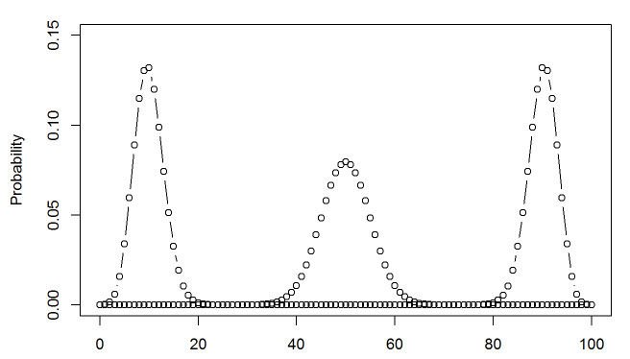
The Binomial Distribution: PMF
P=0.1
P=0.9
P=0.5
Number of successes in 100 trials

Slide 24
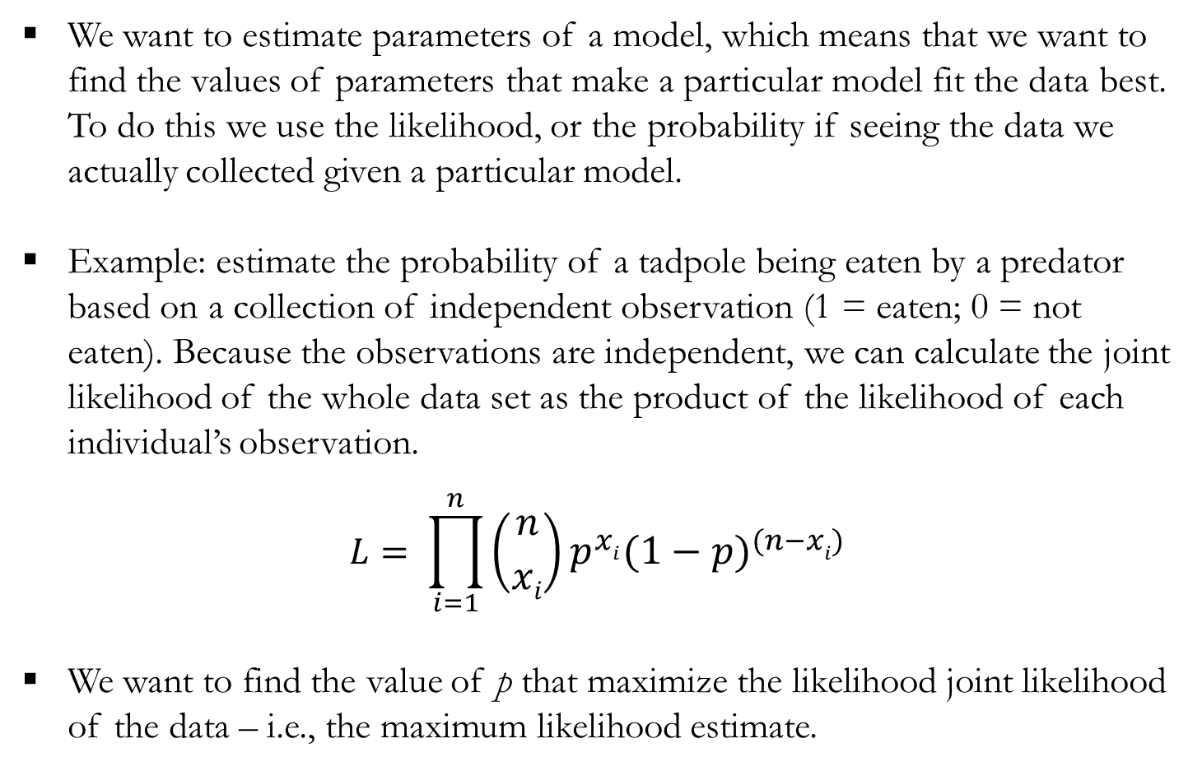
Binomial Likelihood
We want to estimate parameters of a model, which means that we want to find the values of parameters that make a particular model fit the data best. To do this we use the likelihood, or the probability if seeing the data we actually collected given a particular model.
Example: estimate the probability of a tadpole being eaten by a predator based on a collection of independent observation (1 = eaten; 0 = not eaten). Because the observations are independent, we can calculate the joint likelihood of the whole data set as the product of the likelihood of each individual’s observation.
$$L= \prod_{i=1}^{n}{\left({n \atop xi}\right)p^{xi}{(1−p)}^{\left(n−xi\right) }}$$
We want to find the value of p that maximize the likelihood joint likelihood of the data – i.e., the maximum likelihood estimate.

Slide 25
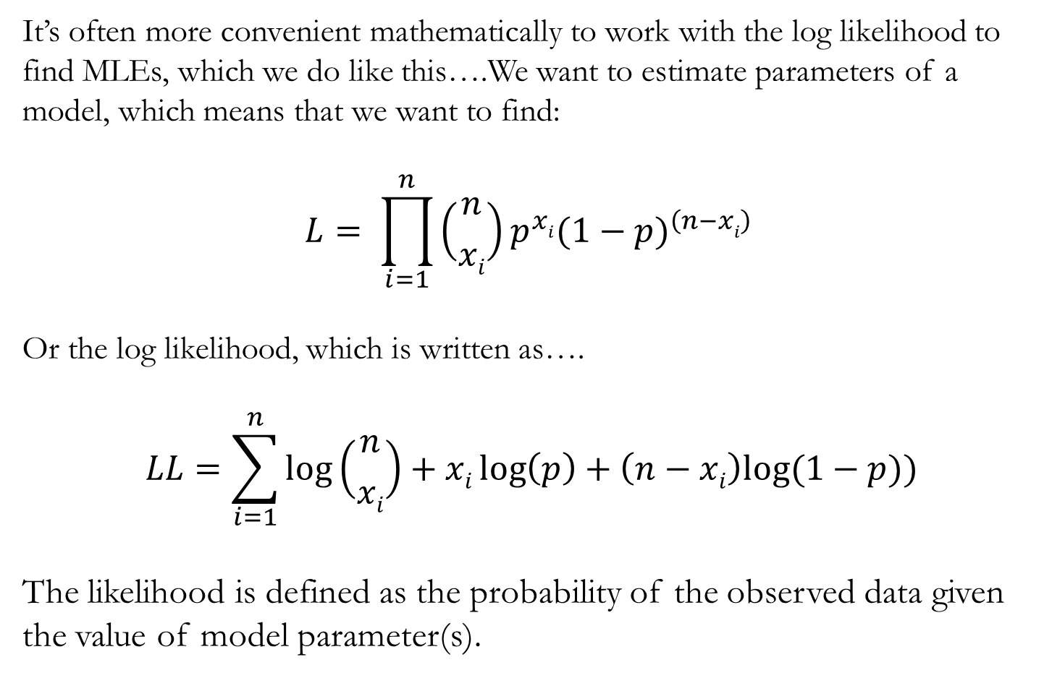
Binomial Likelihood
It’s often more convenient mathematically to work with the log likelihood to find MLEs, which we do like this….We want to estimate parameters of a model, which means that we want to find:
$$L= \prod_{i=1}^{n}{\left({n \atop xi}\right)p^{xi}{(1−p)}^{\left(n−xi\right) }}$$
Or the log likelihood, which is written as….
$$LL=\sum_{i=1}^{n}{log⁡\left({n \atop xi}\right)}+xi\log\left(p\right)+\left(n−xi\right)log⁡(1−p))$$
The likelihood is defined as the probability of the observed data given the value of model parameter(s).

Slide 26
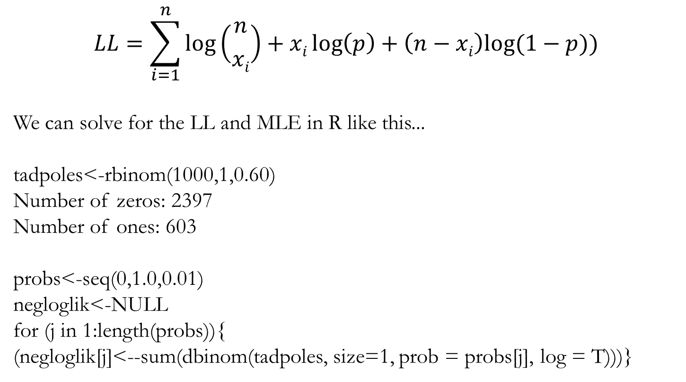
Binomial Likelihood
$$LL=\sum_{i=1}^{n}{log⁡\left({n \atop xi}\right)}+xi\log\left(p\right)+\left(n−xi\right)log⁡(1−p))$$
We can solve for the LL and MLE in R like this...
tadpoles<-rbinom(1000,1,0.60)
Number of zeros: 2397
Number of ones: 603
probs<-seq(0,1.0,0.01)
negloglik<-NULL
for (j in 1:length(probs)){
(negloglik[j]<--sum(dbinom(tadpoles, size=1, prob = probs[j], log = T)))}

Slide 27
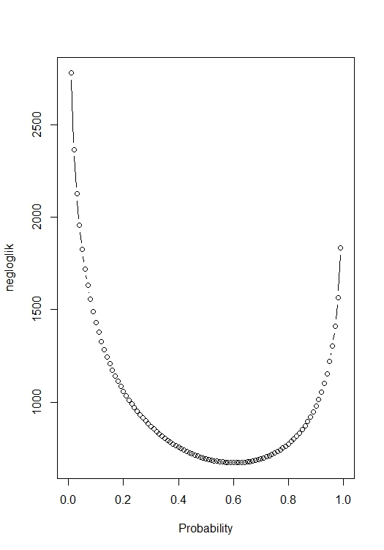
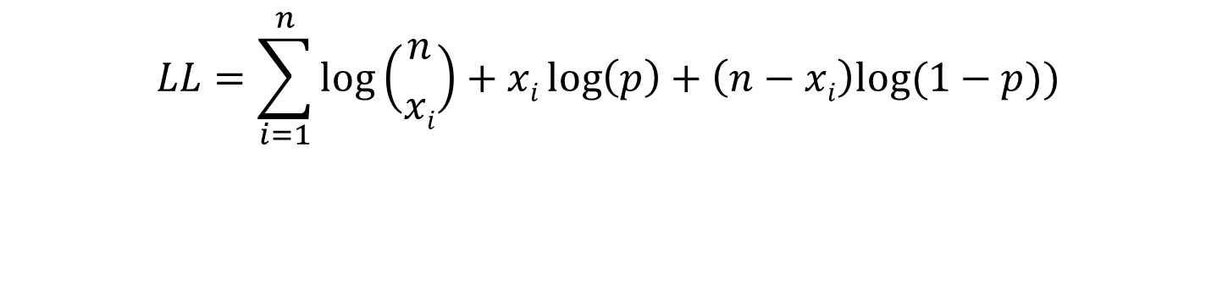
Binomial Likelihood
$$LL=\sum_{i=1}^{n}{log⁡\left({n \atop xi}\right)}+xi\log\left(p\right)+\left(n−xi\right)log⁡(1−p))$$
Solving for MLE in R
probs<-seq(0,1.0,0.01)
negloglik<-NULL
for (j in 1:length(probs)){
(negloglik[j]<--sum(dbinom(tadpoles, size=1, prob = probs[j], log = T)))}
plot(probs,negloglik, type = 'b’)
MLE<-probs[which.min(negloglik)]) = 0.60

Slide 28
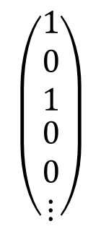

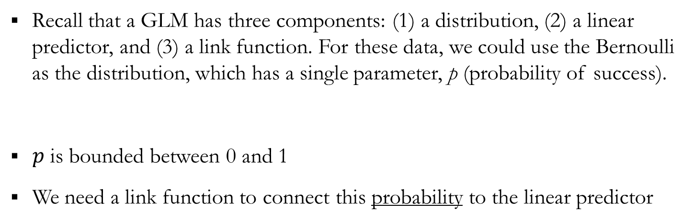


Modeling Binary Data: Logistic Regression
If we sampled (without error) for a species across N sites, we could summarize the occupancy status of each site as either occupied (1) or not-occupied (0)
$$\left(\begin{matrix}\begin{matrix}1 \\ 0 \\ 1\end{matrix} \\ \begin{matrix}0 \\ 0 \\ ⋮\end{matrix}\end{matrix}\right)$$
$$y$$
$$=$$
Recall that a GLM has three components: (1) a distribution, (2) a linear predictor, and (3) a link function. For these data, we could use the Bernoulli as the distribution, which has a single parameter, p (probability of success).
$p$ is bounded between 0 and 1
We need a link function to connect this probability to the linear predictor
$$y_{i}\sim Bernoulli(p_{i})$$

Slide 29
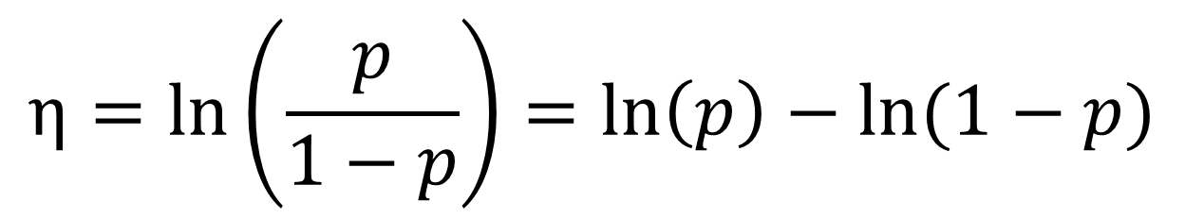
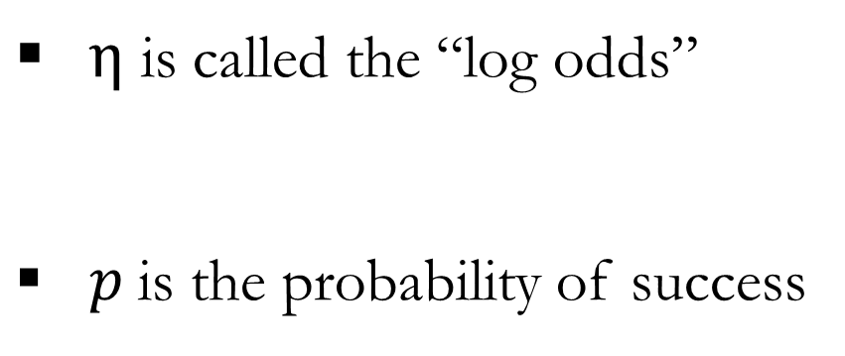
Modeling Binary Data: Logistic Regression
The logit link function
$$η=\ln\left(\frac{p}{1−p}\right)=\ln\left(p\right)−ln⁡(1−p)$$
$η$ is called the “log odds”
$p$is the probability of success

Slide 30
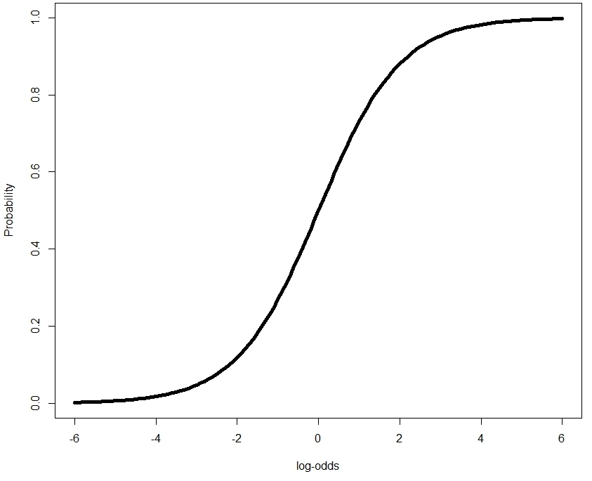
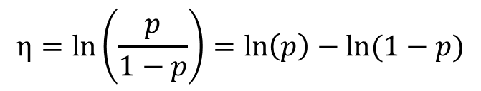
Modeling Binary Data: Logistic Regression
The logit link function
$$η=\ln\left(\frac{p}{1−p}\right)=\ln\left(p\right)−ln⁡(1−p)$$

Slide 31
Modeling Binary Data: Logistic Regression
The logit link function
$$η=\ln\left(\frac{p}{1−p}\right)=\ln\left(p\right)−ln⁡(1−p)$$

Slide 32

Modeling Binary Data: Logistic Regression
The logit link function
$$η=\ln\left(\frac{p}{1−p}\right)=\ln\left(p\right)−ln⁡(1−p)$$
$\ln\left(\frac{0.8}{1−0.8}\right)$ = 1.386

Slide 33
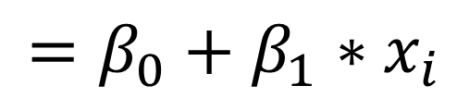
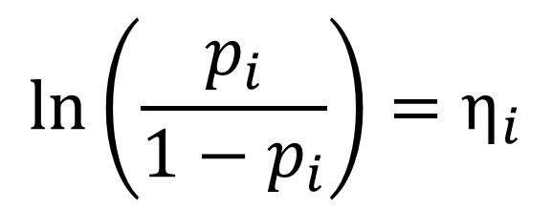
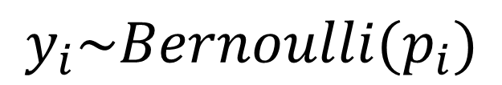


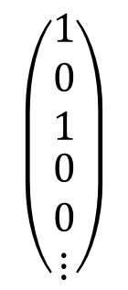
Modeling Binary Data: Logistic Regression
$$\left(\begin{matrix}\begin{matrix}1 \\ 0 \\ 1\end{matrix} \\ \begin{matrix}0 \\ 0 \\ ⋮\end{matrix}\end{matrix}\right)$$
Statistical Distribution
$$y$$
$$=$$
$$y_{i}\sim Bernoulli(p_{i})$$
$${\ln\left(\frac{p_{i}}{1−p_{i}}\right)=η}_{i}$$
$$=β_{0}+β_{1}∗x_{i}$$
Link Function
Linear Predictor
We now have all three components of a GLM

Slide 34
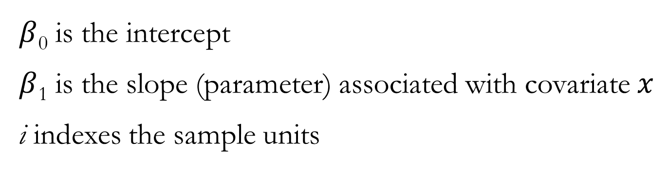
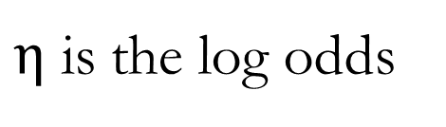
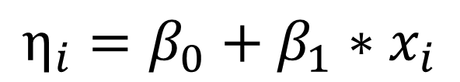
Modeling Binary Data: Logistic Regression
Log odds and the linear predictor
$$η_{i}=β_{0}+β_{1}∗x_{i}$$
$η$ is the log odds
$β$₀ is the intercept
$β$₁ is the slope (parameter) associated with covariate $x$
i indexes the sample units

Slide 35
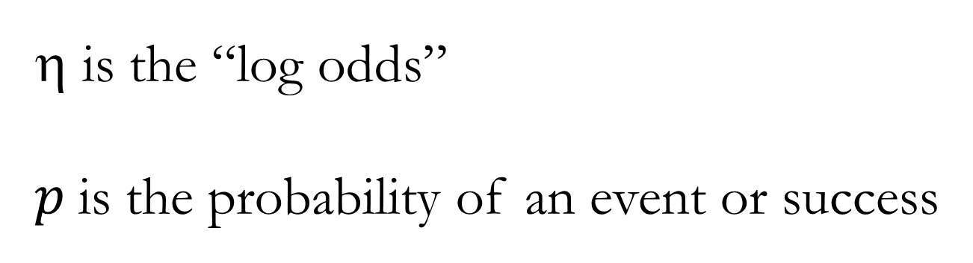
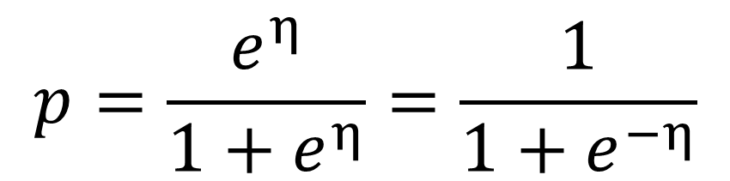
Back Transformation: Inverse Logit Link
Back-transformation to the probability scale
$$p=\frac{e^{η}}{1+e^{η}}=\frac{1}{1+e^{−η}}$$
is the “log odds”
$p$is the probability of an event or success

Slide 36

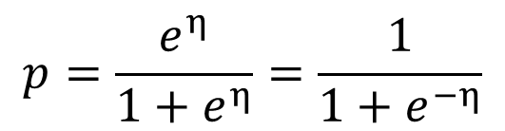
Modeling Binary Data: Logistic Regression
Inverse-logit (back-transformation)
$$p=\frac{e^{η}}{1+e^{η}}=\frac{1}{1+e^{−η}}$$
$\frac{e^{1.386}}{1+e^{1.386}}$= 0.80

Slide 37
Logistic Regression: Interpreting Parameter Estimates
Odds ratios
Parameter estimates are on the logit scale; to interpret we can calculate odds ratios (OR) using the exponential function:
An OR <1 means an event is less likely to occur
An OR = 1 means an event is equally likely to occur
An OR >1 means an event is more likely to occur

Slide 38
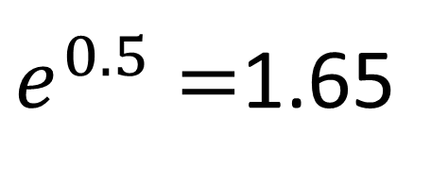
Logistic Regression: Interpreting Parameter Estimates
β₁ = 0.5
$e^{0.5}=$1.65
Interpretation: for each 1 unit increase in X, the event is 1.65 times more likely to occur.
For example, for each 1 inch increase in length, a fish is 1.65 times more likely to be caught.

Slide 39
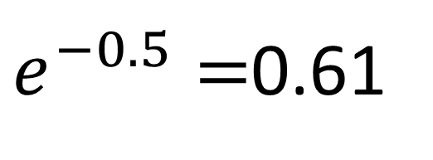
Logistic Regression: Interpreting Parameter Estimates
β₁ = -0.5
$e^{−0.5}=$0.61
Interpretation: for each 1 unit increase in X, the event is 0.61 times as likely or 1.65 (1/0.61) time less likely to occur.
For example, for each 1 inch increase in length, a fish is 1.65 times less likely to be caught.

Slide 40
Summary
Models are very simplified representations of truth
Models are not hypotheses; they are explicit mathematical representations of hypotheses
Multiple models can be constructed to represent the same underlying hypothesis
Information theoretic approaches provide a useful framework for assessing relative support for alternative models
Generalized linear models are a useful and flexible statistical framework for model development

